Slide 1
Introduction to 2D Arrays
ELEC1006: ENGINEERING COMPUTING

Slide 2

Two-Dimensional (2D) Arrays
Can define one array for multiple sets of data.
Like a table in a spreadsheet
Use two size declarators in definition:
const int ROWS = 4, COLS = 3; int exams[ROWS][COLS];
First declarator is number of rows; second is number of columns
PAGE 2

Slide 3
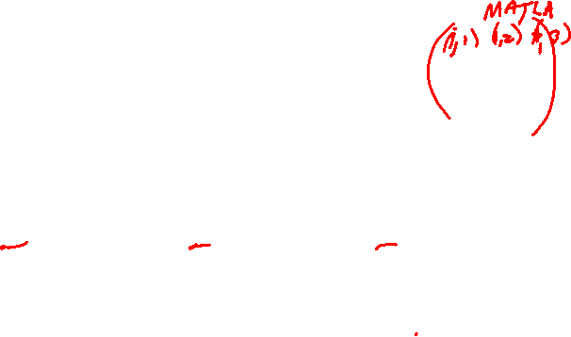
2D Array Representation
const int ROWS = 4, COLS = 3; int exams[ROWS][COLS];
Use two subscripts to access element:
exams[2][2] = 86;
columns
exams[0][0] | exams[0][1] | exams[0][2]
exams[1][0] | exams[1][1] | exams[1][2]
exams[2][0] | exams[2][1] | exams[2][2]
exams[3][0] | exams[3][1] | exams[3][2]
r
o
w
s
PAGE 3

Slide 4
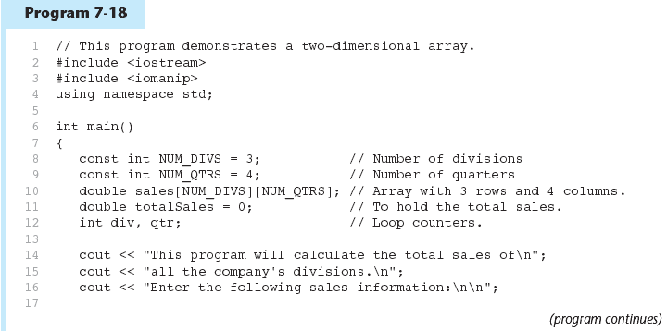
Example 1
PAGE 4

Slide 5
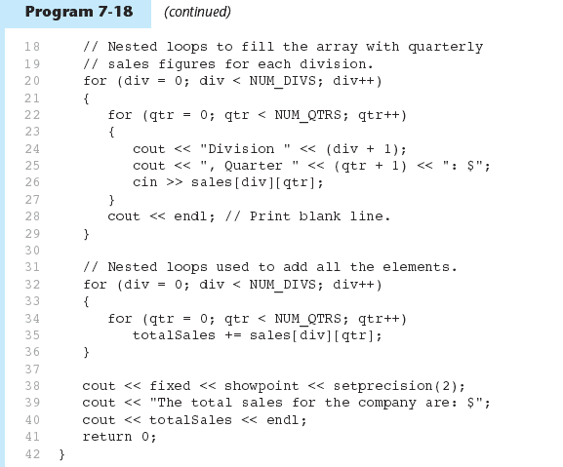
Example 1 (continued)
PAGE 5

Slide 6
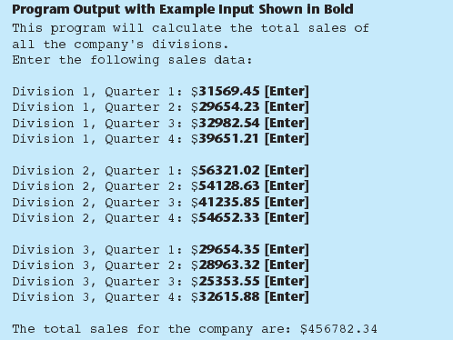
Example 1 (output)
PAGE 6

Slide 7
More info
[1] cplusplus.com: Arrays
https://www.cplusplus.com/doc/tutorial/arrays/
[2] leanrcpp.com: 6.1 – Arrays (Part I) https://www.learncpp.com/cpp-tutorial/61-arrays-part-i/
[3] learncpp.com: 6.2 – Arrays (Part II)
https://www.learncpp.com/cpp-tutorial/62-arrays-part- ii/
[4] learncpp.com: 6.3 – Arrays and loops
https://www.learncpp.com/cpp-tutorial/63-arrays-and- loops/
PAGE 7

